Slide 1

2023 Investor conference
Cheer Time

Slide 2
Disclaimer
The presentation contains projections & estimates of financial information as well as market and product developments for future periods. These projections & estimates are based on information currently available which we believe to be reliable, but they involve risks & uncertainties. Our actual results of operations & financial condition may differ significantly from those contained in projections & estimates. The projections & estimates should not be interpreted as legally binding commitments, but rather as flexible information subject to change occasionally.

Slide 3


AGENDA
About CheerTime
Financial Results
2023 Business Update
Q&A

Slide 4
About Cheer Time
About Cheer Time
Financial Results
2023 Business Update
Q&A

Slide 5
Introduction
Product Category
Cheer Time Enterprise Co., Ltd
Founding Time： 1987/07/28 (Listing on 2009)
Chairman：Minlee Chuang
President：Winston Liu
Product Category： P-Copper、Drilling、PCB
Capital Amount：TWD 640 million
Net Worth：TWD 629 million（2023/9）
Number of Employees： 231
Xinzhuang factory： No.2, Ln. 305, Qionglin S. Rd. Xinzhuang Dist., New Taipei City
Luzhu factory：No.280, Sec. 1, Nanshan Rd. Luzhu Dist., Taoyuan City

Slide 6
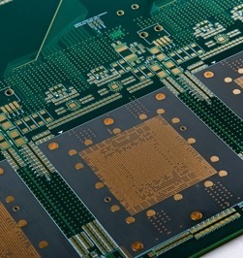
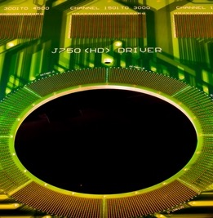
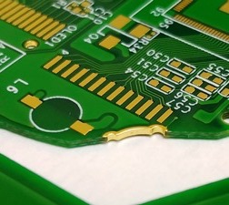
Three business department
1
P-Copper
2
Drilling
3
PCB

Slide 7
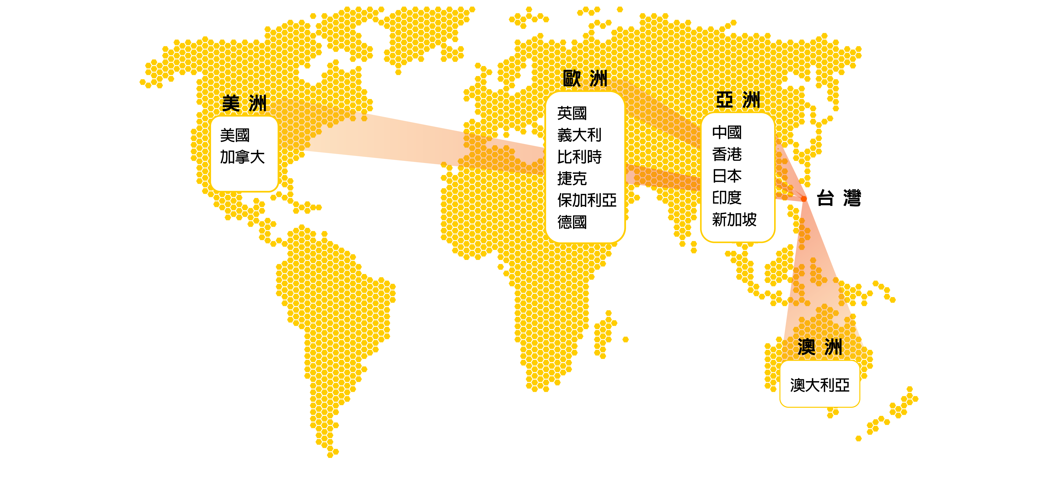
Customer Distribution
UK
Italy
Belgium
Germany
Czech
USA
Canada
China
HK
Japan
India
Singapore
Australia

Slide 8



















Customer List

Slide 9
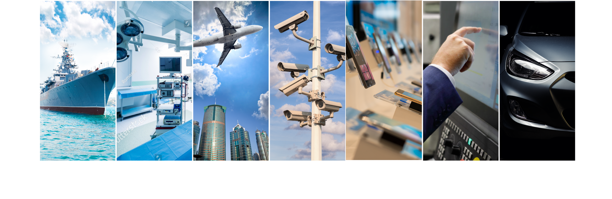
Product Applications
Military
Medical
Aviation
Security
Consumer
Industrial
Automotive

Slide 10
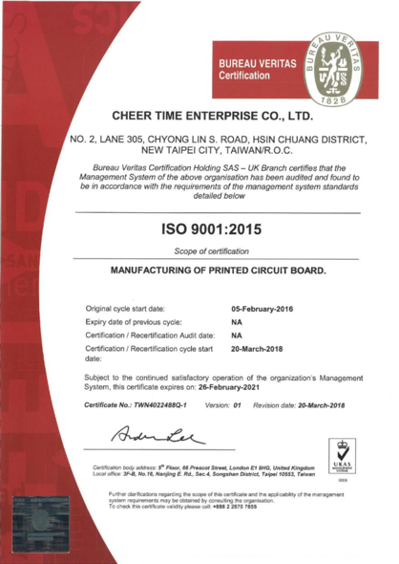
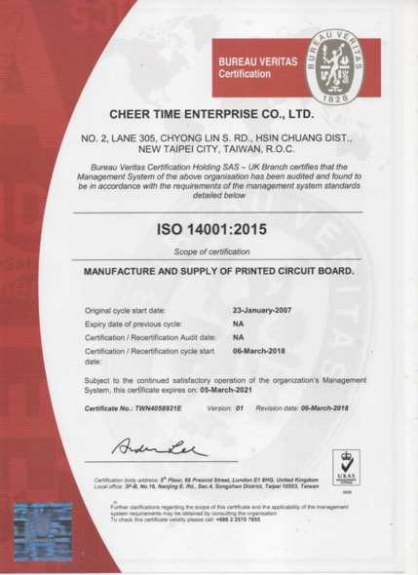
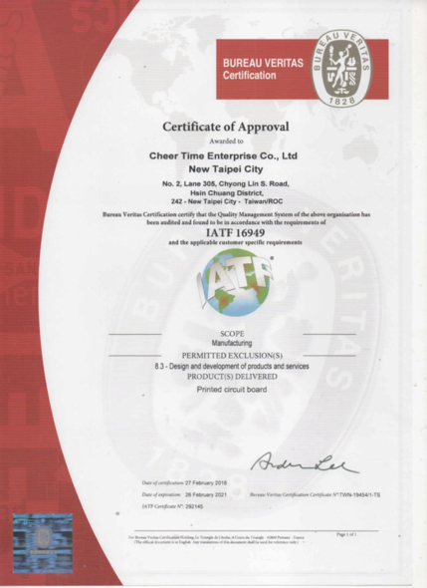
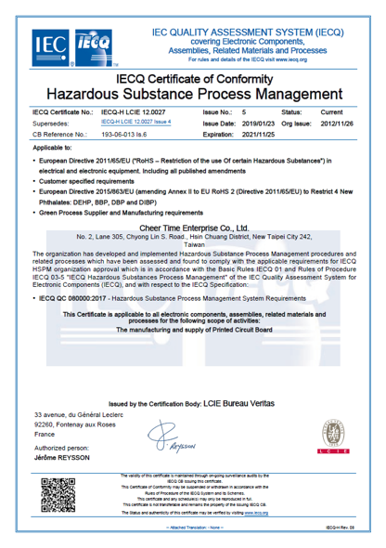
Certification License
ISO 9001
ISO 14001
IATF 16949
QC 080000

Slide 11
Financial Results
About CheerTime
Financial Results
2023 Business Update
Q&A

Slide 12
Revenue Trend

Slide 13
Profitability Trend

Slide 14
Gross Margin and Net Income Trend

Slide 15
Financial Structure

Slide 16
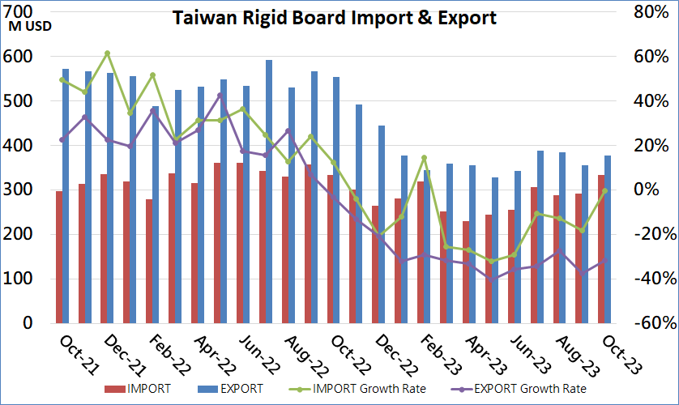
PCB Industry overview
Source : TPCA

Slide 17
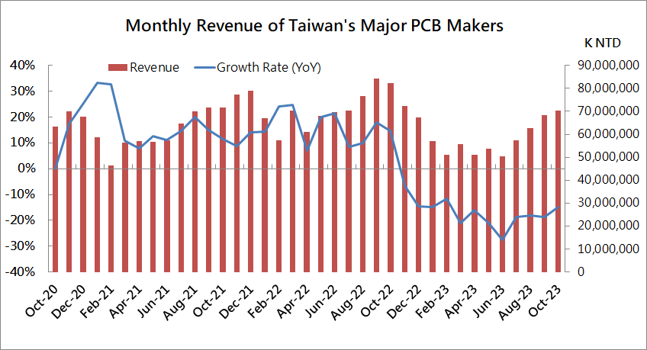
PCB Industry overview
Source : TPCA

Slide 18
Revenue Trend

Slide 19
Revenue distribution
Drilling
P-copper
PCB

Slide 20
Profitability Trend

Slide 21
Gross Margin and Net Income Trend

Slide 22
Financial Structure

Slide 23
Cash Flow from Operating Activities

Slide 24
2023 Business Update
About CheerTime
Financial Results
2023 Business Update
Q&A

Slide 25
2023 Business Update
Stable financial structure
  Debt ratio remains below 35%
  Positive cash flow from operations
  The bank's quota utilization rate remains below 40%
Business remains stable despite industrial recession
  Deeply develop customer relationships and provide one-stop service
  The conversion rate of sample orders to mass production continues to increase
  Strengthen production management capabilities

Slide 26
2023 Business Update
New management team creates new atmosphere in factory affairs
  Reducing purchasing and personnel costs
  Continuously improve process and production quality
ESG sustainable environment
  Complete the Greenhouse Gas Emission Inventory Report of Scope 1 and Scope 2
  Promote low-carbon and smart energy efficiency improvement plans
Notes:
1.111 年度類別1(範疇1)之排放量為 1243.1485 公噸 CO2e/年，類別2(範疇2)
之排放量為 1910.9612 公噸 CO2e/年，類別 1+類別 2 之排放量為 3154.1097
公噸 CO2e/年，其中以外購用電占全廠年排放量比例約 61%為最大。

Slide 27
Q&A
Thanks for listing

